Slide 1
DI-322 Web Technologies
Web Services:

Slide 2
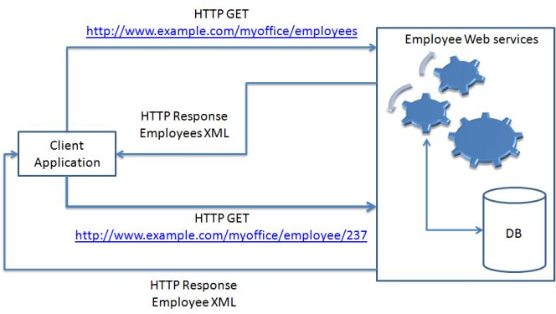
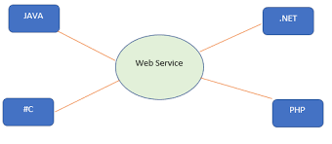
8. Web Services :
Basic Operation:
Definition: Web services are software systems designed to support
interoperable machine-to-machine interaction over a network.
They enable communication between various applications or systems regardless of the programming languages or platforms they are built on.
They typically use standard protocols like HTTP, XML, and JSON for communication and data representation.
Example: An example of a web service is a weather service that provides weather forecasts to various applications or websites.

Slide 3
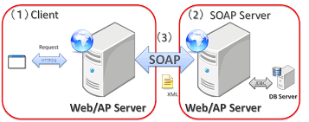
8. Web Services : SOAP
SOAP stands for Simple Object Access Protocol.
It is a XML-based protocol for accessing web services.
SOAP is a W3C recommendation for communication between two applications.
SOAP is XML based protocol. It is platform independent and language independent. By using SOAP, you will be able to interact with other programming language applications.
Advantages of Soap Web Services
WS Security: SOAP defines its own security known as WS Security.
Language and Platform independent: SOAP web services can be written in any programming language and executed in any platform.
Disadvantages of Soap Web Services
Slow: SOAP uses XML format that must be parsed to be read. It defines many standards that must be followed while developing the SOAP applications. So it is slow and consumes more bandwidth and resource.

Slide 4
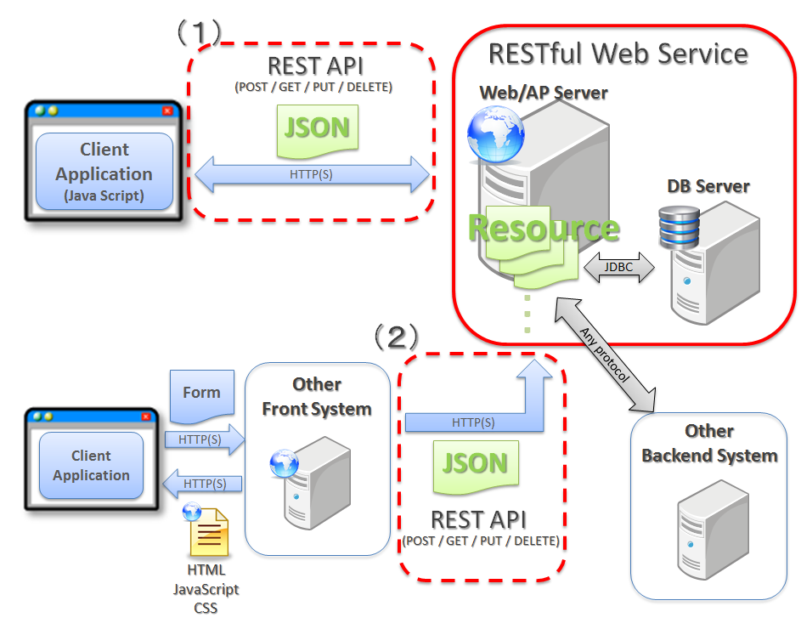
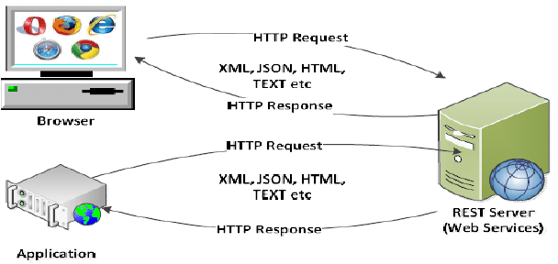
8. Web Services : RESTful
REST stands for REpresentational State Transfer.
REST is an architectural style not a protocol
Advantages of Soap Web Services
Fast: RESTful Web Services are fast because there is no strict specification like SOAP. It consumes less bandwidth and resource.
Language and Platform independent: RESTful web services can be written in any programming language and executed in any platform.
Permits different data format: RESTful web service permits different data format such as Plain Text, HTML, XML and JSON

Slide 5
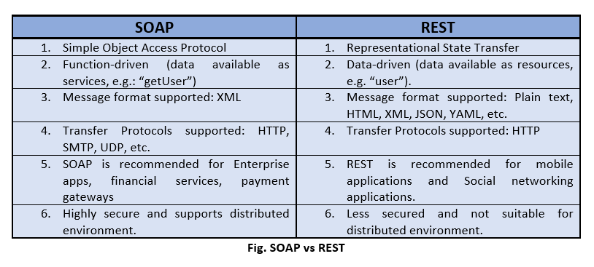
8. Web Services : SOAP vs RESTful

Slide 6
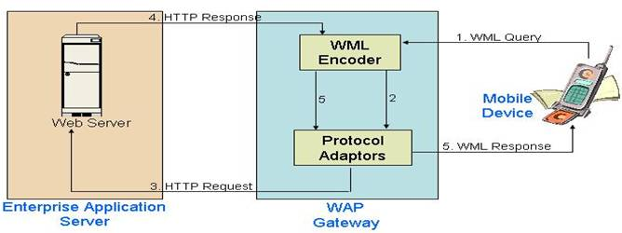
8. Web Services : WML
WML (Wireless Markup Language)
used for designing web pages intended for wireless devices such as mobile phones
It is based on XML and is used to create lightweight and efficient web content for mobile browsers
Explanation: WML is specifically designed for devices with limited processing power, memory, and display capabilities. It allows developers to create mobile-friendly web pages by defining elements like decks, cards, and menus optimized for small screens and limited input methods.

Slide 7
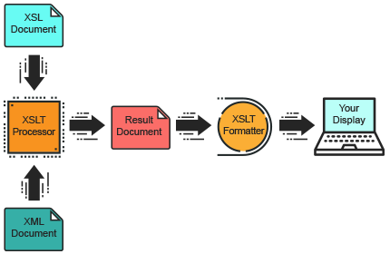
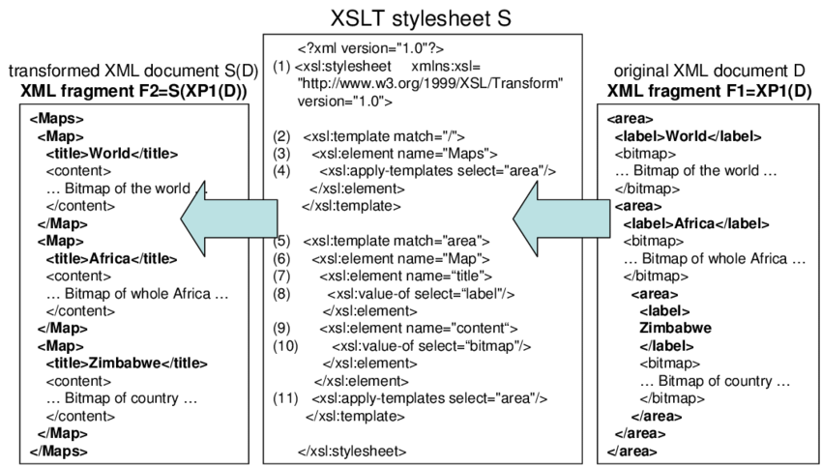
8. Web Services : XSL
XSL (Extensible Stylesheet Language)
XSL is a family of languages used to transform and render XML documents into different formats such as HTML, PDF, or plain text.
It consists of three parts:
XSLT for transforming XML documents,
XPath for navigating XML documents, and
XSL-FO for formatting XML documents.

Slide 8
8. Web Services : Operations
XSL (Extensible Stylesheet Language)
facilitate communication and data exchange between different applications over the internet.
They perform operations such as:
Data Retrieval (GET): Fetching data from a server
Data Submission (POST): Sending data to a server
Data Modification (PUT/PATCH): Updating existing data on the server.
Data Deletion (DELETE): Removing data from the server.
Authentication and Authorization: Controlling access to resources.
Data Filtering and Sorting: Refining data based on specific criteria.
Error Handling: Managing errors gracefully for better user experience (e.g., displaying meaningful error messages).

Slide 9
8. Web Services : Cookie Coordination
Small Data: Cookies are tiny pieces of data stored on a user's device by websites they visit.
Browsing Aid: They assist websites in remembering user preferences, login status, and other browsing-related information.
Session Management: Cookies help manage user sessions, allowing users to stay logged in across multiple pages or visits.
Tracking: They enable tracking of user behavior and activities on websites for analytics and advertising purposes.
Personalization: Cookies are often used to personalize content and tailor the browsing experience to individual users.
Stored in Browser: Cookies are stored in the user's web browser and can be accessed by the website that created them during subsequent visits.
Privacy Concerns: While useful, cookies raise privacy concerns due to their ability to track user activities across different websites.

Slide 10
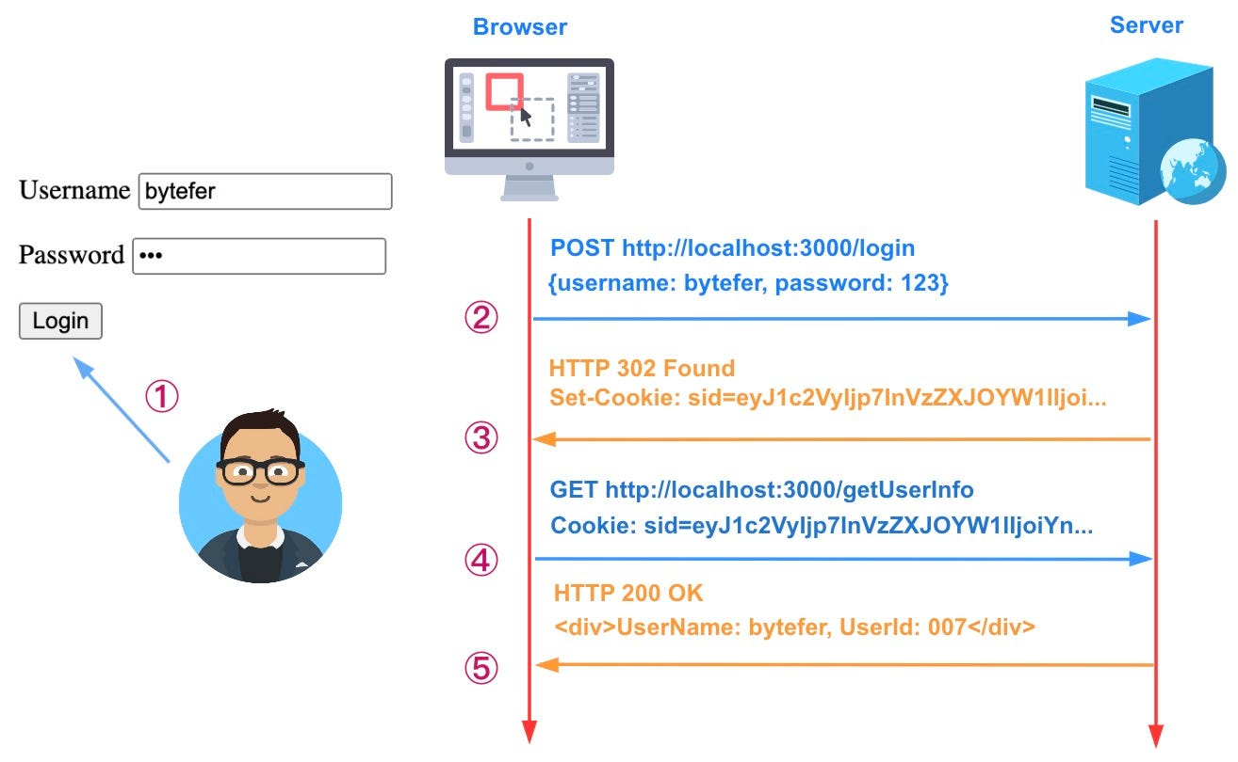
8. Web Services : Operations
XSL (Extensible Stylesheet Language)
facilitate communication and data exchange between different applications over the internet.
They perform operations such as:
Data Retrieval (GET): Fetching data from a server
Data Submission (POST): Sending data to a server
Data Modification (PUT/PATCH): Updating existing data on the server.
Data Deletion (DELETE): Removing data from the server.
Authentication and Authorization: Controlling access to resources.
Data Filtering and Sorting: Refining data based on specific criteria.
Error Handling: Managing errors gracefully for better user experience (e.g., displaying meaningful error messages).

Slide 11
8. Web Services : Privacy and P3P Privacy and Platform for Privacy Preferences (P3P)
Privacy:
Protection of users' personal information and the control they have over how their data is collected, used, and shared by websites and online services.
Usage: Websites implement privacy measures such as data encryption, secure login systems, and privacy policies to safeguard users' personal information.
Examples: User consent prompts for cookies, opt-out mechanisms for data collection, secure payment gateways for financial transactions, and privacy policies outlining how user data is handled by the website.

Slide 12
8. Web Services : Privacy and P3P Privacy and Platform for Privacy Preferences (P3P)
Platform for Privacy Preferences (P3P):
A protocol developed by the World Wide Web Consortium (W3C) that allows websites to declare their privacy policies in a machine-readable format, enabling web browsers to automatically interpret and enforce those policies.
Usage: Websites publish P3P policies in the form of compact privacy statements embedded in HTTP headers or linked from web pages. Web browsers then use these policies to inform users about the website's data collection and usage practices, helping users make informed decisions about sharing their personal information.
Examples: A website might use P3P to declare its policy on cookies, stating whether they are used for tracking, authentication, or personalization. When a user visits the website, their browser can automatically check the site's P3P policy and notify the user if it matches their privacy preferences or if there are potential privacy risks.

Slide 13
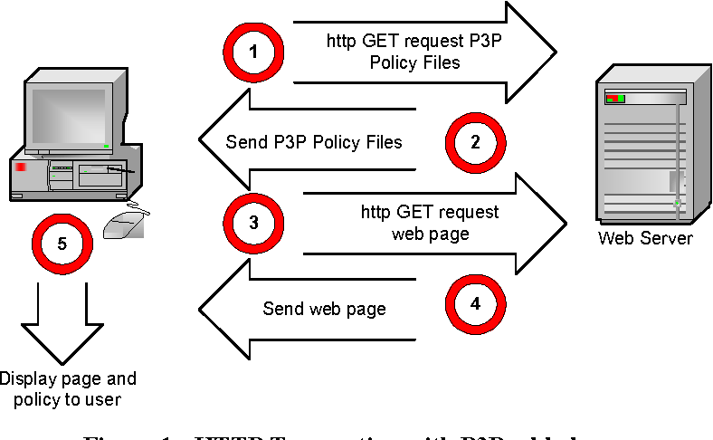
8. Web Services : Privacy and P3P Privacy and Platform for Privacy Preferences (P3P)

Slide 14
8. Web Services : Complex HTTP Interactions
Sophisticated exchanges of data and requests between clients and servers using the HTTP protocol, often involving multiple steps, dependencies, and conditions.
Scenarios:
Web applications requiring dynamic content, authentication, and data manipulation.
API integrations with third-party services micro-services architectures.
Real-time communication implementations.
Example: in an e-commerce platform:
A user adds items to their shopping cart, triggering HTTP requests to update the cart's contents.
Upon checkout, the platform communicates with payment gateways via HTTP to process transactions securely.
Additionally, HTTP interactions manage inventory updates, order tracking, and confirmation emails, often involving authentication, authorization, and error handling mechanisms.

Slide 15
8. Web Services : Dynamic Content Delivery
serving customized and interactive web content to users based on various factors such as user preferences, device type, location, and real-time data.
This content is generated dynamically on the server-side or client-side in response to user requests, providing a personalized and engaging browsing experience.
Usage Areas:
E-commerce websites that display personalized product recommendations, promotions, and user-specific pricing.
Social media platforms that dynamically update news feeds, notifications, and user-generated content based on interests and interactions.
Streaming services that deliver personalized recommendations, playlists, and content recommendations based on viewing history and preferences.
Real-time collaborative applications such as document editing tools, online gaming platforms, and messaging apps that synchronize content across multiple users in real-time.

Slide 16
8. Web Services : Dynamic Content Delivery
Example: An example of dynamic content delivery is seen in different websites:
Upon visiting the website, the server generates personalized recommendations based on the user's browsing history and preferences.
As the user scrolls through the page, additional content is dynamically loaded via AJAX requests, ensuring a seamless browsing experience without page refreshes.
Interactive elements such as polls, quizzes, and comment sections allow users to actively engage with the content and provide feedback.
The website may also incorporate geolocation data to deliver localized news and events relevant to the user's location.

Slide 17
8. Web Services : Server Configuration & Server Security
Server configuration: The setup and optimization of server software and settings to ensure efficient performance, scalability, and reliability.
Example: Setting up load balancing and clustering to distribute incoming traffic across multiple servers for improved reliability and scalability.
Configuring caching mechanisms to reduce server load and improve response times for frequently accessed content.
Server security: involves implementing measures to protect the server, its data, and the applications hosted on it from unauthorized access, data breaches, and cyber threats.
Example: Implementing strong password policies and multi-factor authentication (MFA) to prevent unauthorized access to server accounts.
Configuring firewall rules to restrict incoming and outgoing network traffic based on predefined security policies and access controls.
Regularly monitoring server logs and employing intrusion detection systems to identify and mitigate potential security threats in real-time.

